Slide 1
Municipal waste separation
2.G.
GAS

Slide 2
Separation
The purpose of separation is the economic recovery of separated waste components and at the same time reducing the amount of mixed waste.
By sorting waste, people can contribute to environmental protection, which is very important to us.

Slide 3
Separation in Slovakia
Municipal waste production in Slovakia is growing.
And it wasn't different in 2020, it was a year of pandemic, from which people expected the growth of waste production to slow down.
In Slovakia, more waste was produced despite the lockdown, when people spent more time at home.
In 2020, for every single person in Slovakia, there was 2.5% more municipal waste than in the record year of 2019

Slide 4
Separation in Slovakia
Why did waste production grow?
Despite the fact that we spend more time at home during the lockdown, we cannot avoid the generation of waste.
One example to explain the situation is the delivery of goods and meals to the doors of our homes packed in multi-layer and disposable packaging.

Slide 5
Separation in Slovakia
Most waste in the west, least in the east of Slovakia
Waste generation in 2020 was different in each region. The highest amount of waste for each person was in the Trnava, Bratislava and Nitra regions. More than 500 kg of municipal waste for year.
The least municipal waste was created last year by people from the regions of eastern Slovakia. In the Košice region it was 363 kg and in the Prešov region 349 kg for each person .

Slide 6
Separation in Slovakia
Region, year 20220 | Municipal waste production in kg- person | Share of recovered municipal waste in % | Municipal waste recycling rate in % | Municipal waste recycling rate in %
Bratislavský | 531 | 73,45 | 43,71 | 25,51
Trnavský | 584 | 47,25 | 47,22 | 52,73
Trenčiansky | 431 | 42,65 | 42,45 | 57,33
Nitriansky | 521 | 44,71 | 44,69 | 55,25
Žilinský | 452 | 45,73 | 45,53 | 54,27
Banskobystrický | 392 | 43,46 | 43,45 | 56,54
Prešovský | 349 | 42,49 | 41,91 | 57,47
Košický | 363 | 66,76 | 39,36 | 33,24

Slide 7
Separation in Slovakia
On the other hand, the recycling rate was calculated at 43.7% and about 8% of municipal waste was recovered for electricity or heat in energy recovery facilities.

Slide 8
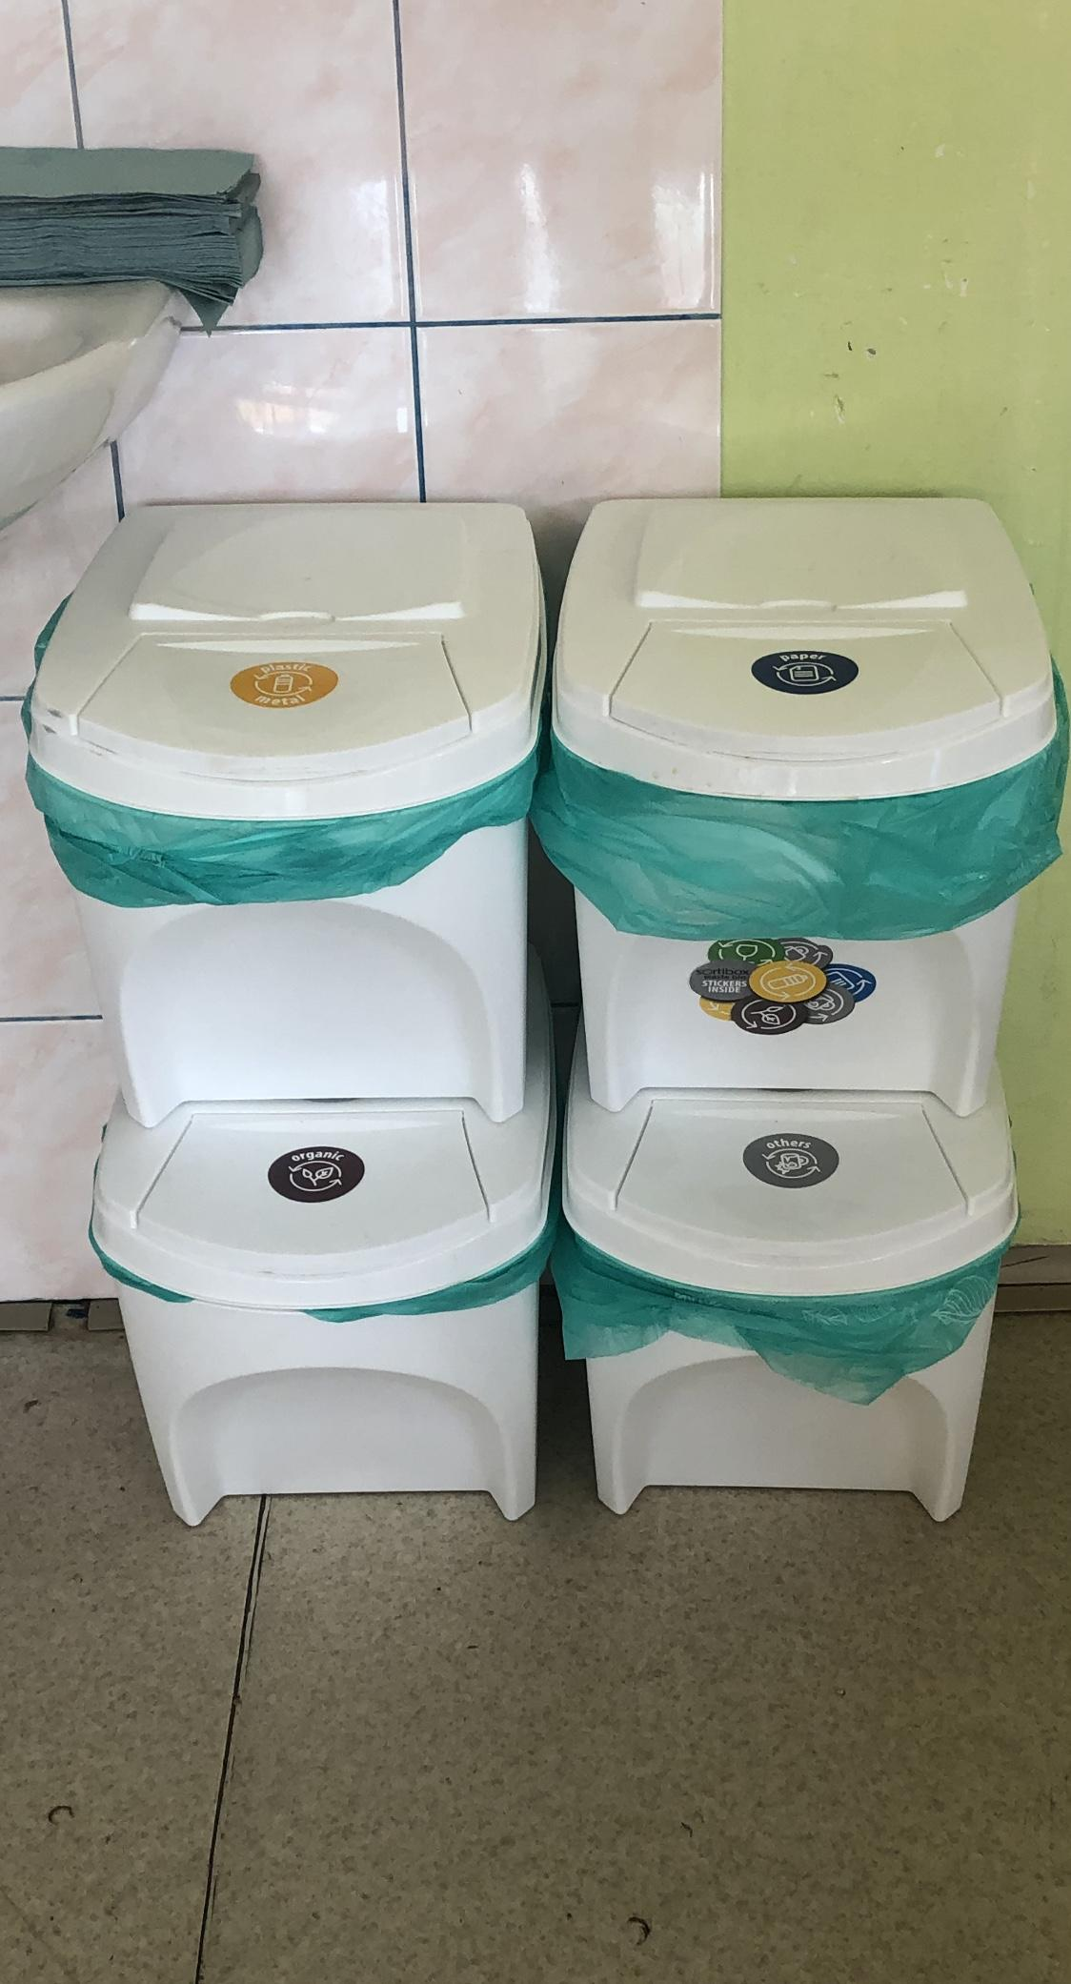
Separation in our school
If we want to make Slovakia a more beautiful and healthier country, we need to help.
Our school has decided to help support the separation project. In every class we have separation baskets and instructions on how to separate correctly.
Because even if someone wants to sort waste but doesn’t know how, his efforts are useless, because it hasn’t got any effect.

Slide 9
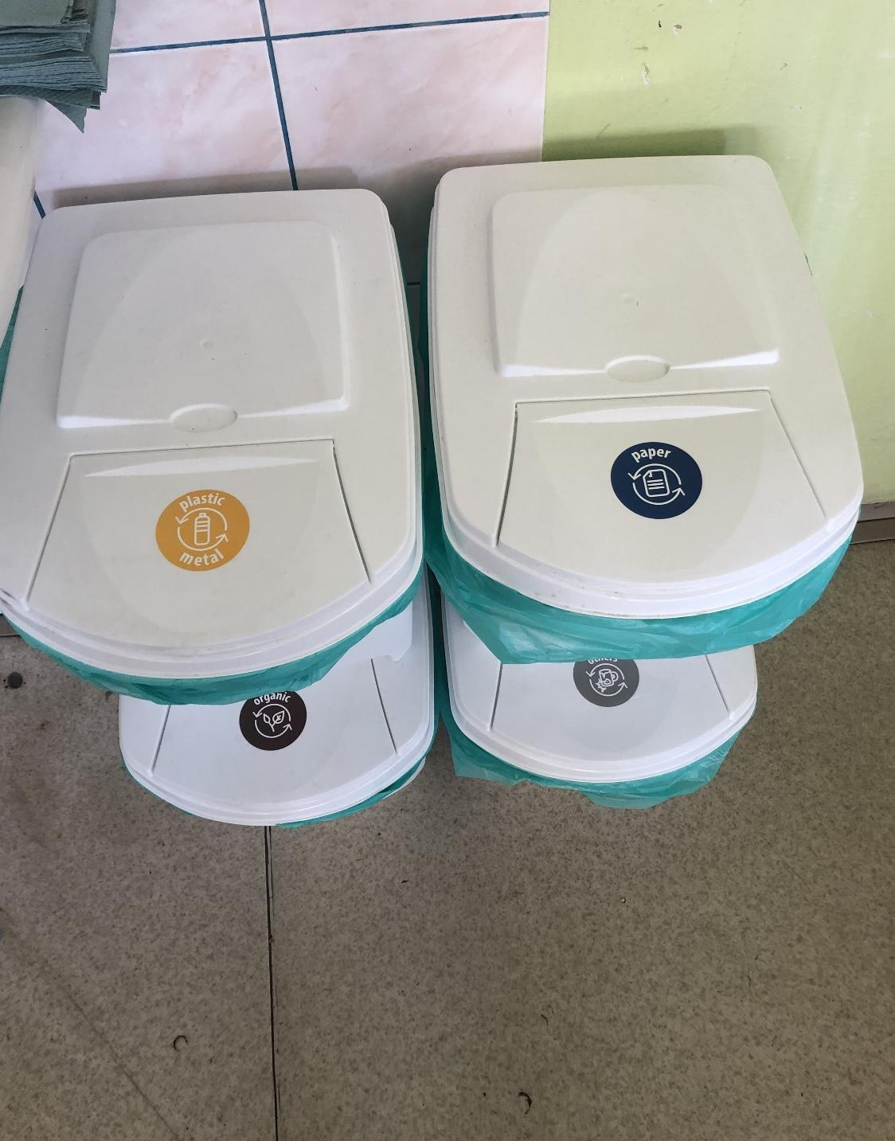
Separation in our school
Fortunately, separation becomes completely natural for students, sorting becomes an active part of our lives.
A person who is aware of the importance of separation for nature translates his views into practical life. It becomes a living example of good behavior towards nature.
Our grammar school contributes to the education of such a person.

Slide 10
Separation in companies
Manufacturing companies and factories in Slovakia have to evaluate the report of disposal of waste, because this obligation arises from the law.

Slide 11
Separation in companies
Their duty is to properly store waste in marked containers, mark it, and sort it according to the type of waste. The waste is passed on to companies, which valorize it, dispose it and process it as environmentally friendly as possible.
For example old machine tires or plastic are crushed and mixed together for production of asphalt.
Textile fents or old clothes are used, for example, in the production of textile fibers.
In Krupina, many companies also have to sort waste. They have to pay fees for waste, which amount depends on the type and amount of waste.
In companies that work with wood, there is also a large amount of waste that needs to be properly stored or processed.
Pieces of wood that will no longer be needed in the manufacture of furniture are used for space heating or can be brought to the collection yard.
Chips, shavings and sawdust are thrown into containers for biowaste, or into compost.
Packaging in which wood always comes packed (plastic, cardboard, polystyrene) is thrown into bins designed for that.

Slide 12
Separation in our city
General rules of waste management
The waste collection system is declared a city system in the entire territory of the town of Krupina.
It is strictly forbidden to move containers from designated places
The city provides mass collection
Collection, transport and places for disposal of bulky waste
Collection and transport of bulky waste takes place at least twice a year
The Municipal Office shall ensure that citizens are informed well in advance of the collection of bulky waste by special notification.
Landfill during working hours and outside the time of organized collection of bulky waste by the city.

Slide 13
Green containers:
non-returnable glass containers for beverages, glass containers, plate glass, glass shards,...
Do not throw!
porcelain, ceramics, car glass, mirrors, TV screens,...
Stained glass

Slide 14
Yellow containers:
bottles, cups, plastic bags, foils, polystyrene
Do not throw! package from dangerous substances, for example motor oils, chemicals,...
Plastic

Slide 15
Blue containers:
newspaper, magazines, office paper, boxes, cartons,...
Do not throw! soiled paper, used diapers and hygienic products
Paper

Slide 16
Red containers:
Metal covers, cans, metal products, aluminum foil
Do not throw! metal covers combined with other packaging, for example toothpaste
Cans

Slide 17
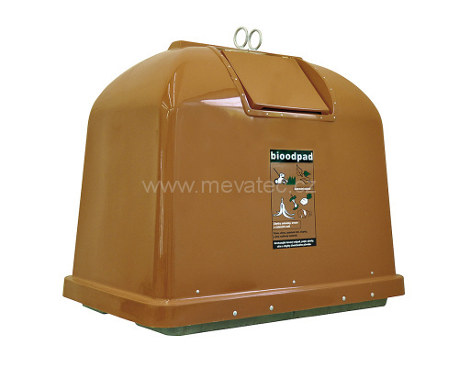
Brown containers
biowaste
Belongs here: biologic degradable waste from gardens, fruit and vegetable peels, coffee and tea residues

Slide 18
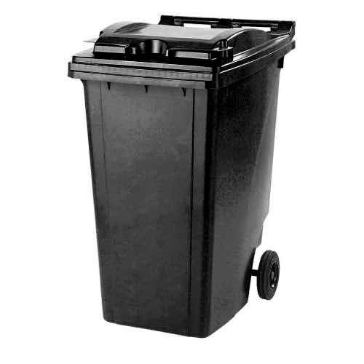
Black containers
Mixed municipal waste: is unsorted waste or waste after sorting the components of municipal waste.

